Slide 1

Semantisk model for HCA Repository v*
Registry Repository
Diary Repository
Derived Attributes from Title/Description
(json)
References-In-Diary-Section
M
M
M
M
1
1
1
1
Diary-Section-Text-Foot-Notes
Registry-Reference (see-/also)
Registry
(Vol. 11-12)
References-In-Diary-Page
Diary-Section-Text
M
1
1
M
M
1
1
M
1
1
Subtypes
Person-Registry
(Vol. 11)
Work-Registry
(Vol. 12)
Location -Registry
(Vol. 12)
M
M
Place-Derived-From-Diary-Section-Text
Date-Derived-From-Page-Diary-Section-Text
M
1
Digital Map
(1800 and present)
M
M
M
M
M
M
M
M
1
M
Sørens
Sted register
eventYear
Sørens
Artist register
1
Gregorian-Calendar (1800)
compositionYearDate
publicationYearDate
1
birthyear/Date:
deathYearDate
1
1
M-M relationship mellem Work-Reg og Place/Location (Sørens 2. register)

Slide 2
Semantisk model for HCA Repository v0.x*
Udlede Star-Schema
Registry Repository
Diary Repository
Registry
(Vol. 11-12)
References-In-Diary-Page
Diary-Page/ Section-Text
1
M
M
1
M
Subtypes
Person-Registry
(Vol. 11)
Work-Registry
(Vol. 12)
Location -Registry
(Vol. 12)
M
M
M
M
M-M relationship mellem Work-Reg og Place/Location (Sørens 2. register)
Sørens
Artist register
Sørens
Sted register
Gregorian-Calendar (1800)
1
1
Sørens
Almanak

Slide 3
Semantisk model for HCA Repository v0.82*
Udlede Star-Schema
Registry Repository
Diary Repository
Registry
(Vol. 11-12)
References-In-Diary-Page
Diary-Page/ Section-Text
1
M
M
1
Værk, Sted og Person
M
Gregorian-Calendar (1800)
1
Dagbogsdag
1

Slide 4
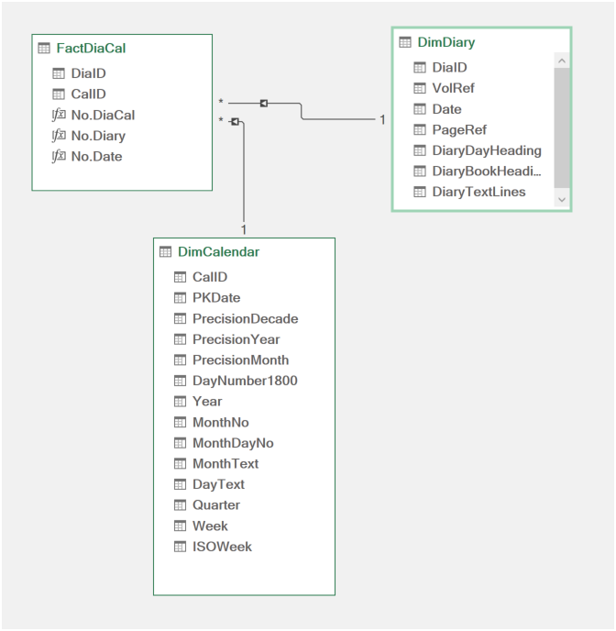
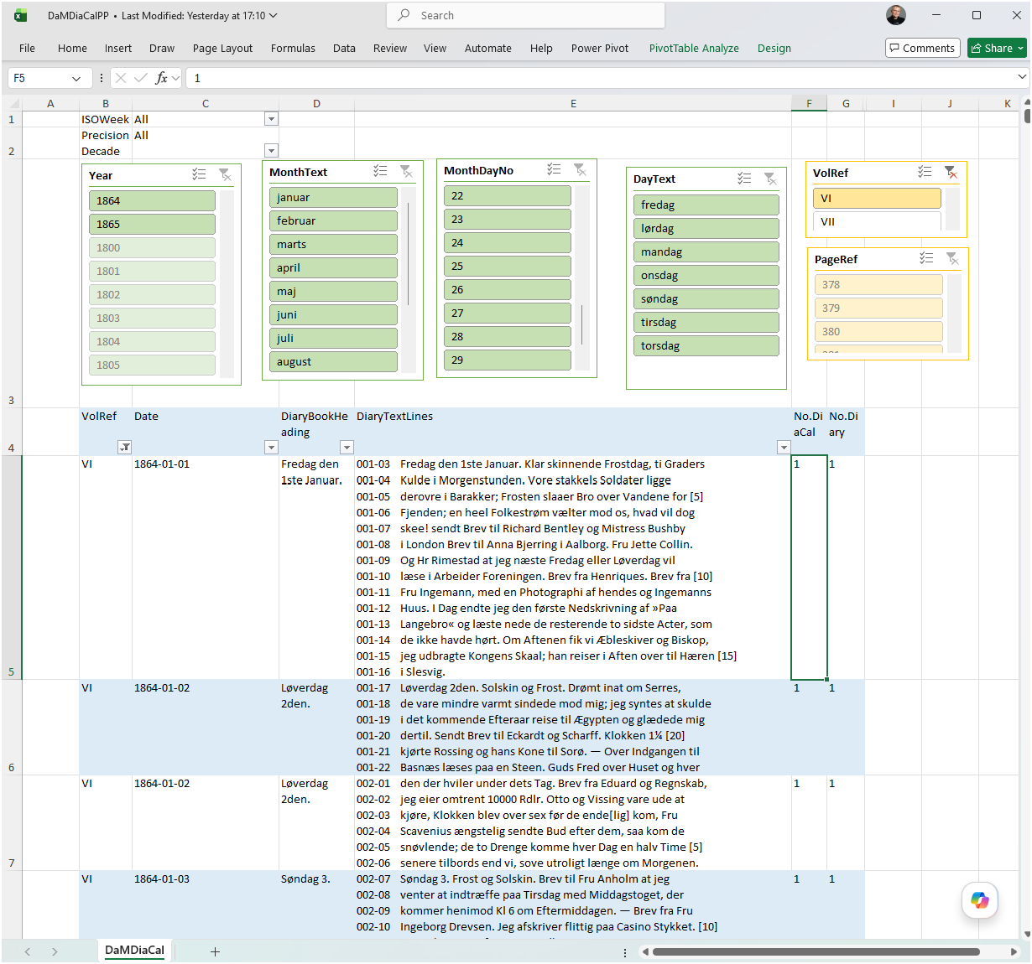
Star-Schema med Dimensions/Facts model for HCA Repository v0.91*
Diary Repository
Dimension og Fact – Power Pivot Data Model
Dimensions
Diary-Page/ Section-Text
Facts
M
Gregorian-Calendar (1800)
Dimensions
1
Dagbogsdag
1

Slide 5
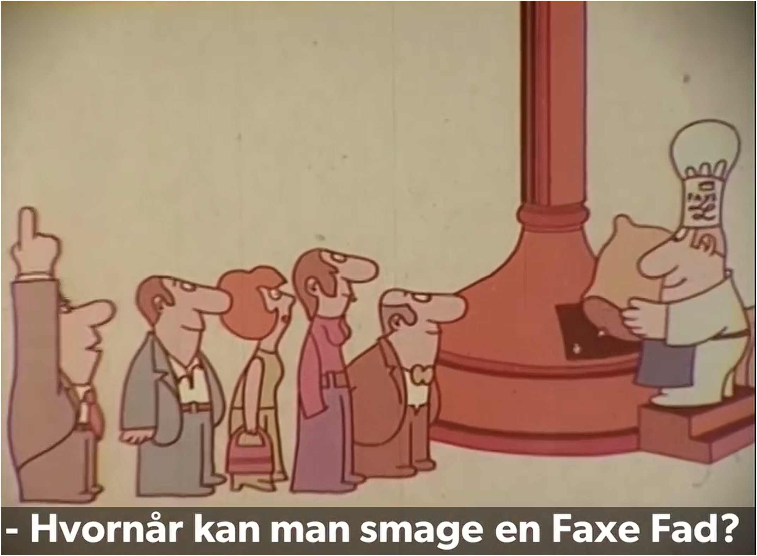
Semantisk Dimensions/Facts model for HCA Repository v0.91*
Diary Repository
Diary-Page/ Section-Text
M
Gregorian-Calendar (1800)
1
Dagbogsdag
1
Notes:
Når den bliver serveret

Slide 6
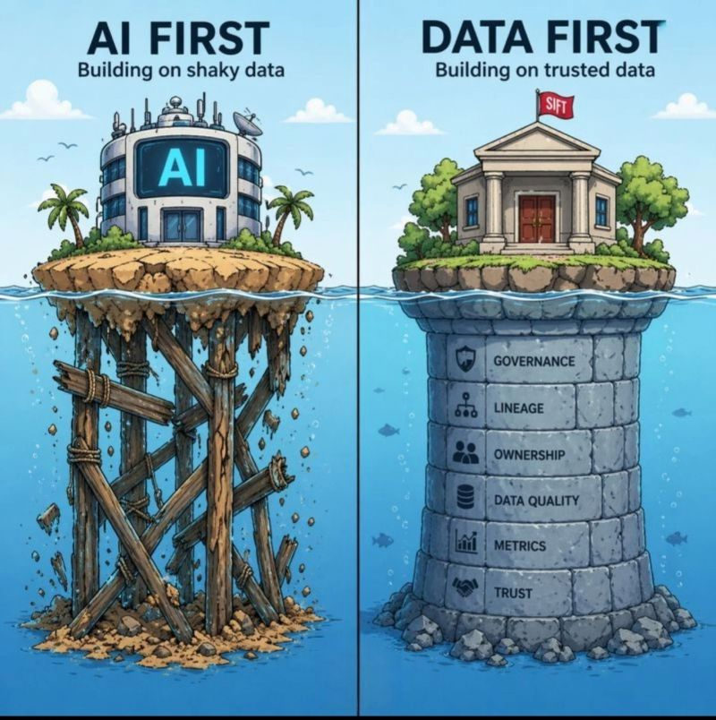
Semantisk Dimensions/Facts model for HCA Repository v0.91*
Diary Repository
*
Diary-Page/ Section-Text
M
Gregorian-Calendar (1800)
1
Dagbogsdag
1
Post og diskussion på LinkedIn.
*UI
Notes:
Når den bliver serveret

Slide 7
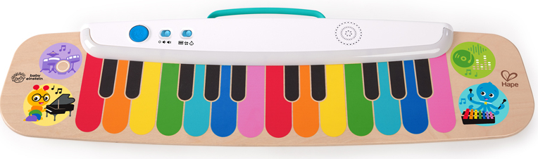
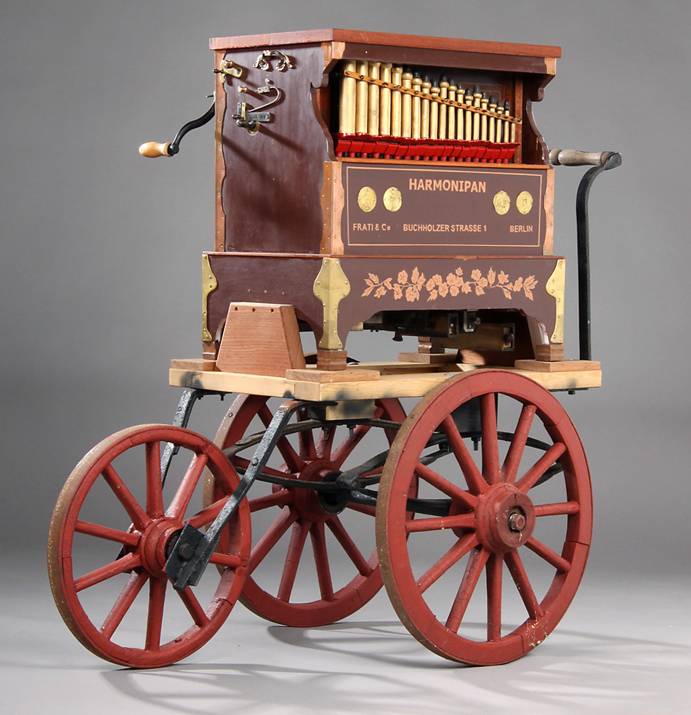
Ambitionsniveau Fætter BR-keyboard, Lirekassen (Excel-MVP)
Lille Peter Edderkop
Dengang jeg drog afsted

Slide 8
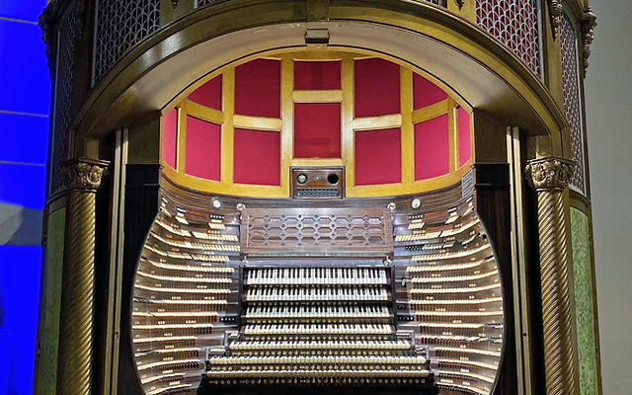
Orgel med 7+ keyboards over 30+ oktaver (i Excel-MVP)
Max Reger Fantasia and Fugue on B-A-C-H

Slide 9
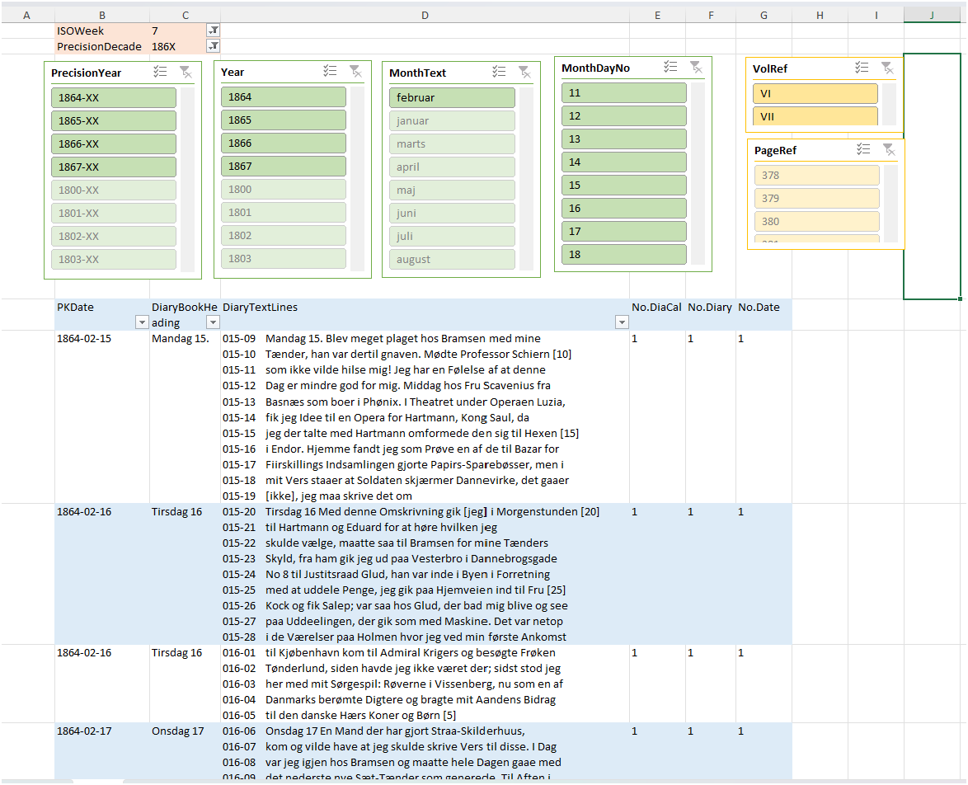
Orgel med 7+ keyboards over 30+ oktaver (i Excel-MVP)
Max Reger Fantasia and Fugue on B-A-C-H

Slide 10
Ambitionsniveau Fætter BR-keyboard, Lirekassen eller Orgel med 7+ keyboards over 30+ oktaver (Excel-MVP)
Lille Peter Edderkop
Max Reger Fantasia and Fugue on B-A-C-H
Dengang jeg drog afsted

Slide 11
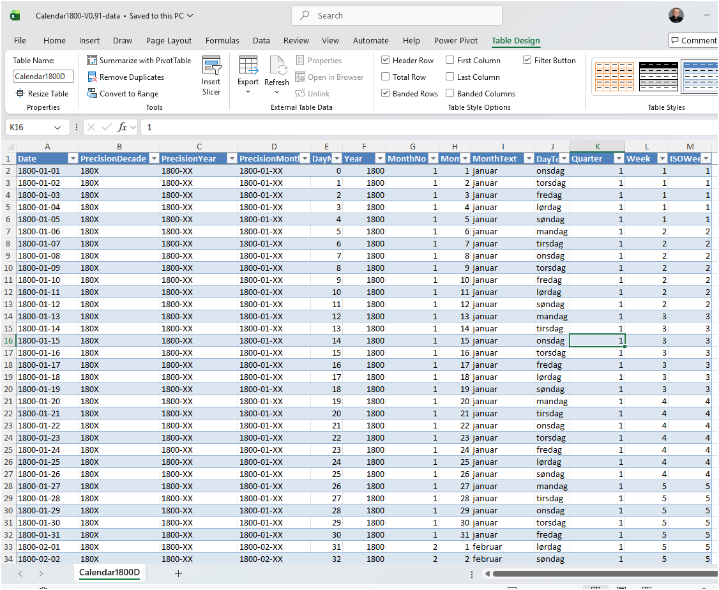
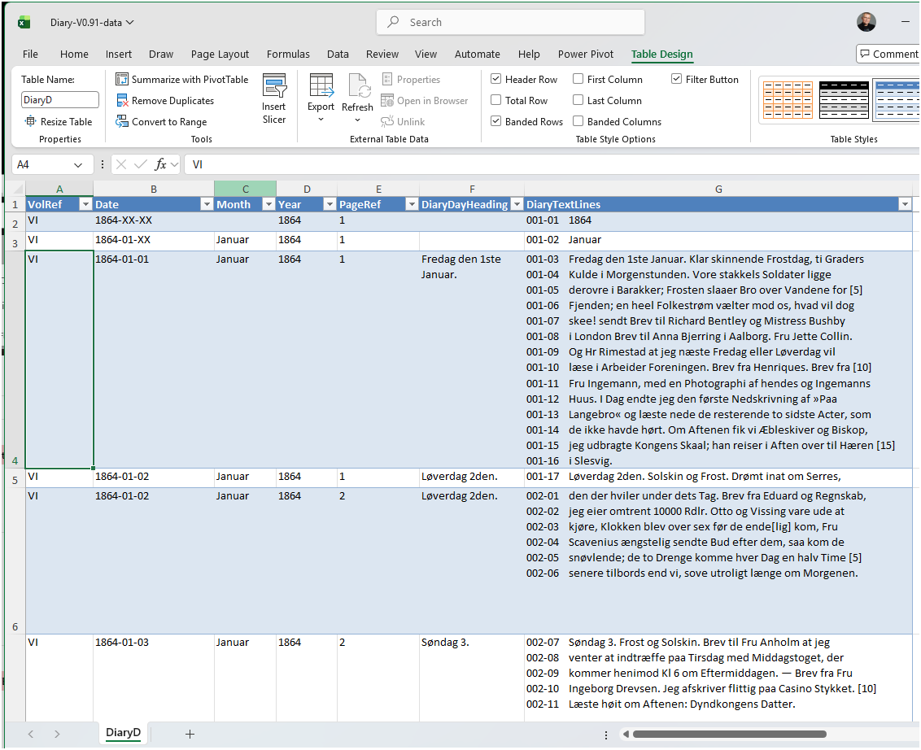
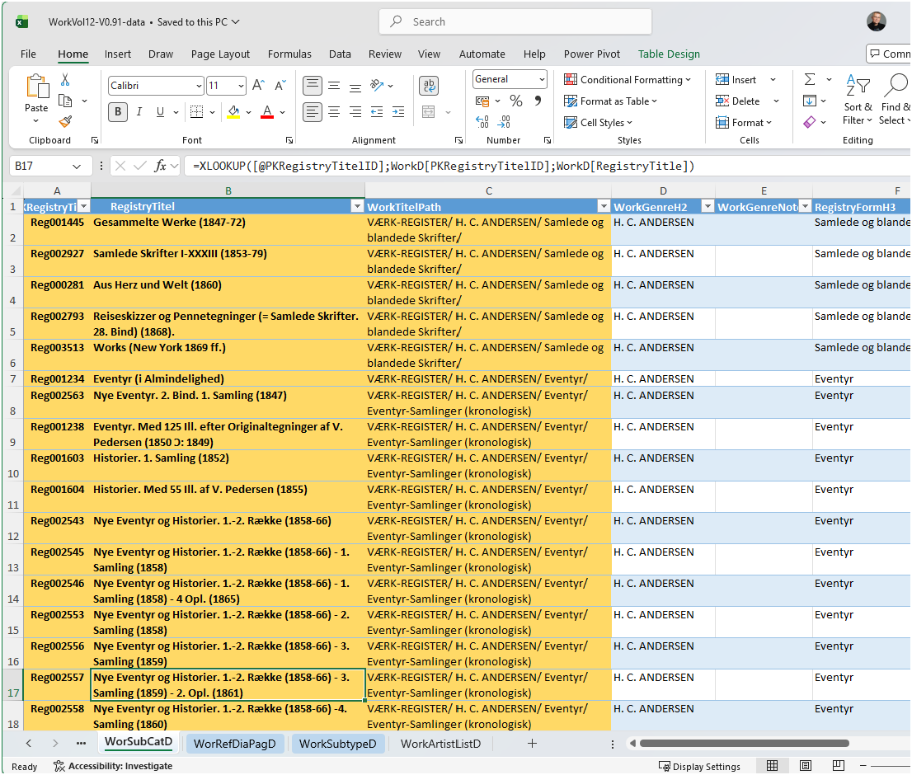
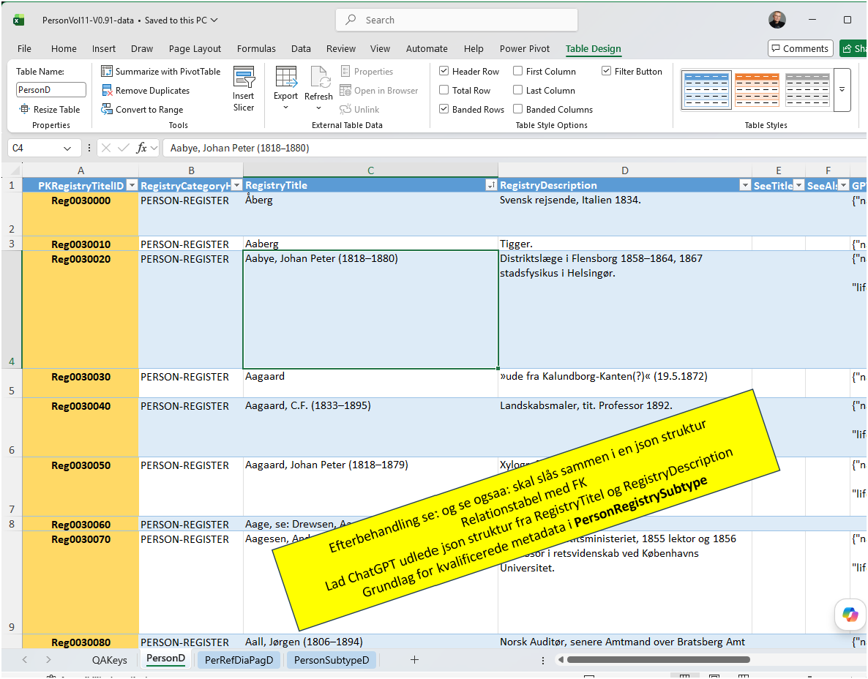
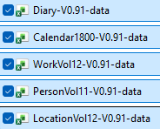
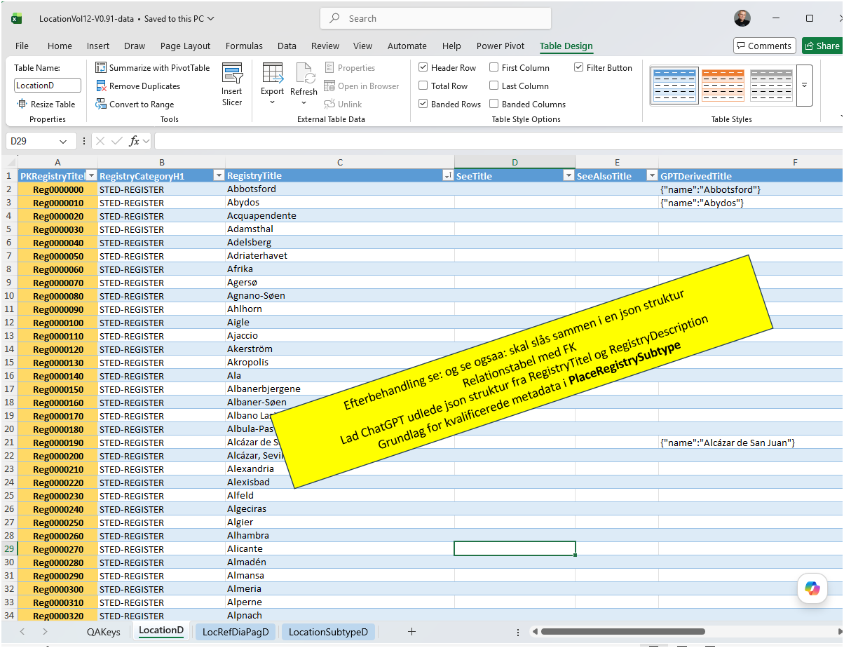
Bygge en fuld-skala MVP i Excel (med Power Query og Power Pivot)
Kalender
Dagbøger
Værker
Personer
Steder
Excel
Data-tabeller i Excel

Slide 12
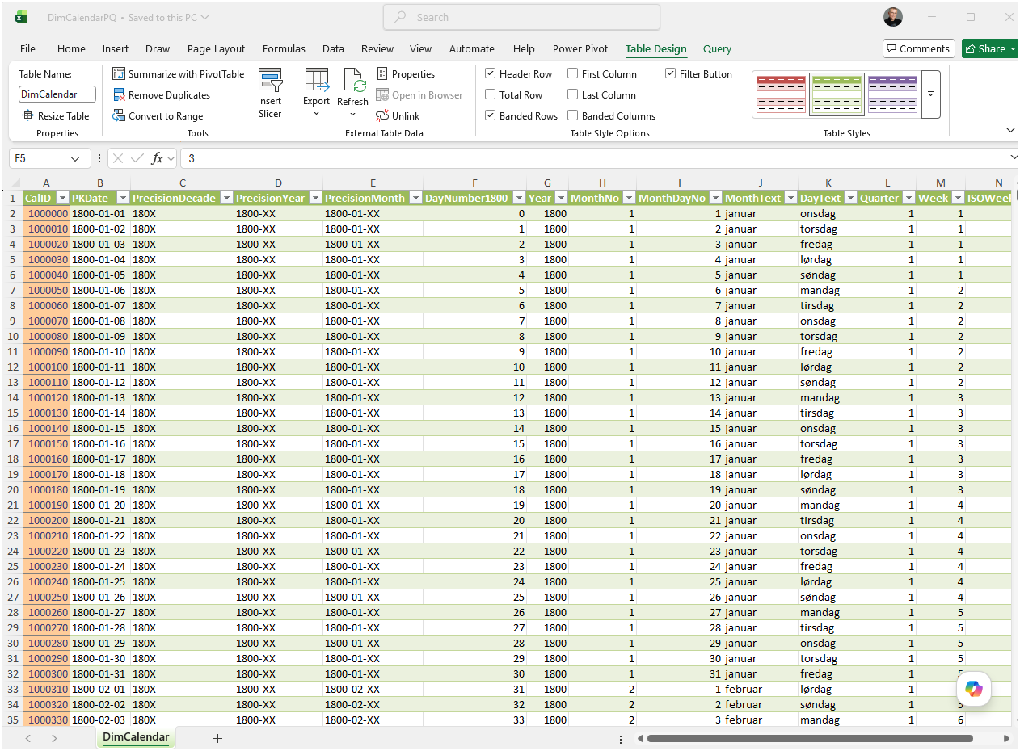
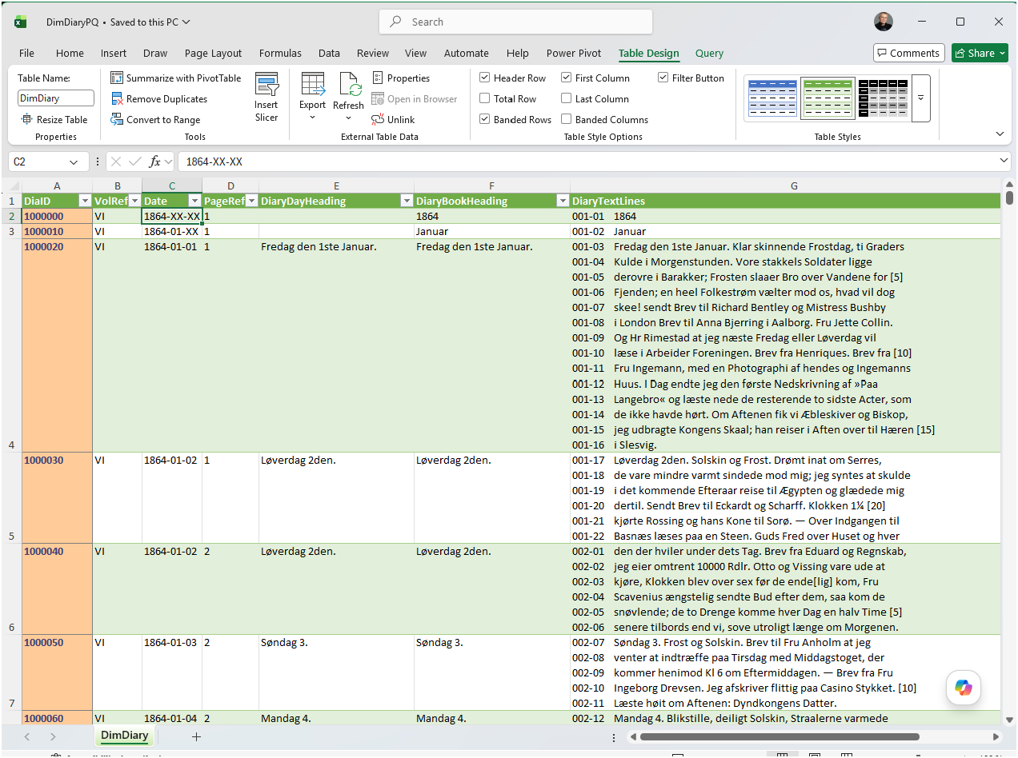
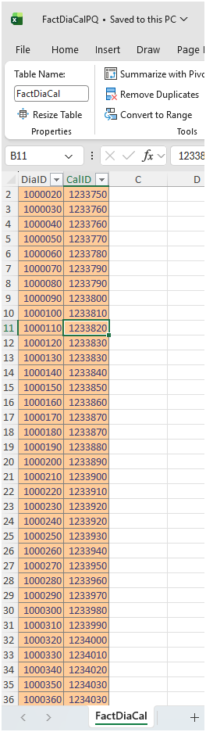
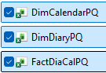
Bygge en fuld-skala MVP i Excel (med Power Query og Power Pivot)
Dimensions-Calendar
Dimensions-Diary
Excel
Power Query
Fact-Diary-Celendar
Dimension og Fact tabeller i Power Query baseret på Excel-tabeller

Slide 13
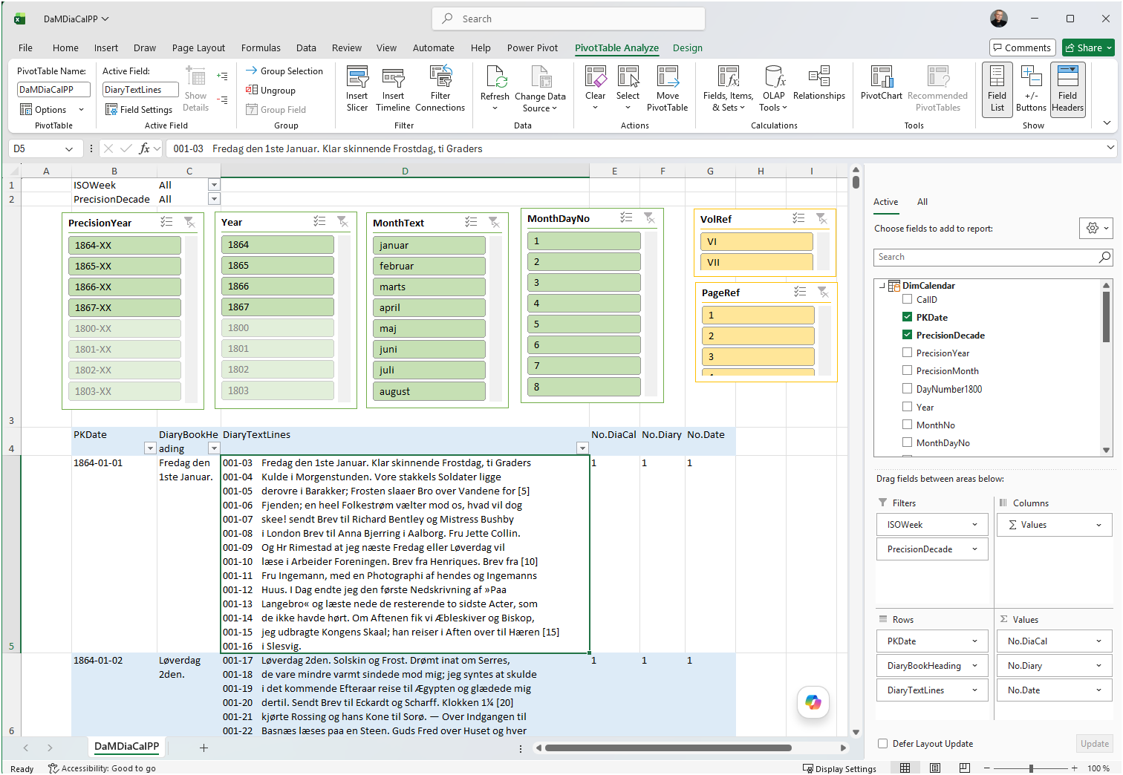
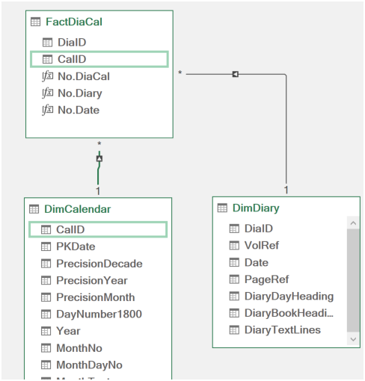
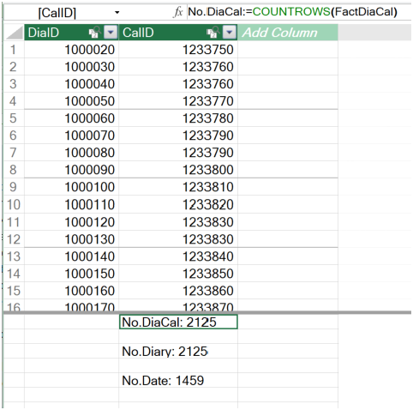
Bygge en fuld-skala MVP i Excel (med Power Query og Power Pivot)
Power Pivot
Pivot Tabel
Power Pivot Star-Schema modeller (Dimension og Fact tabeller) baseret på Power Query-tabeller

Slide 14
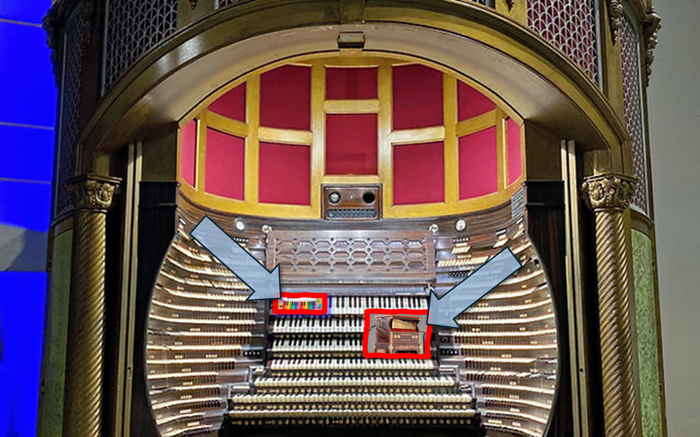
Bygge en fuld-skala MVP i Excel (med Power Query og Power Pivot)
Power Pivot
Pivot Tabel
Excel Pivot tabeller

Slide 15
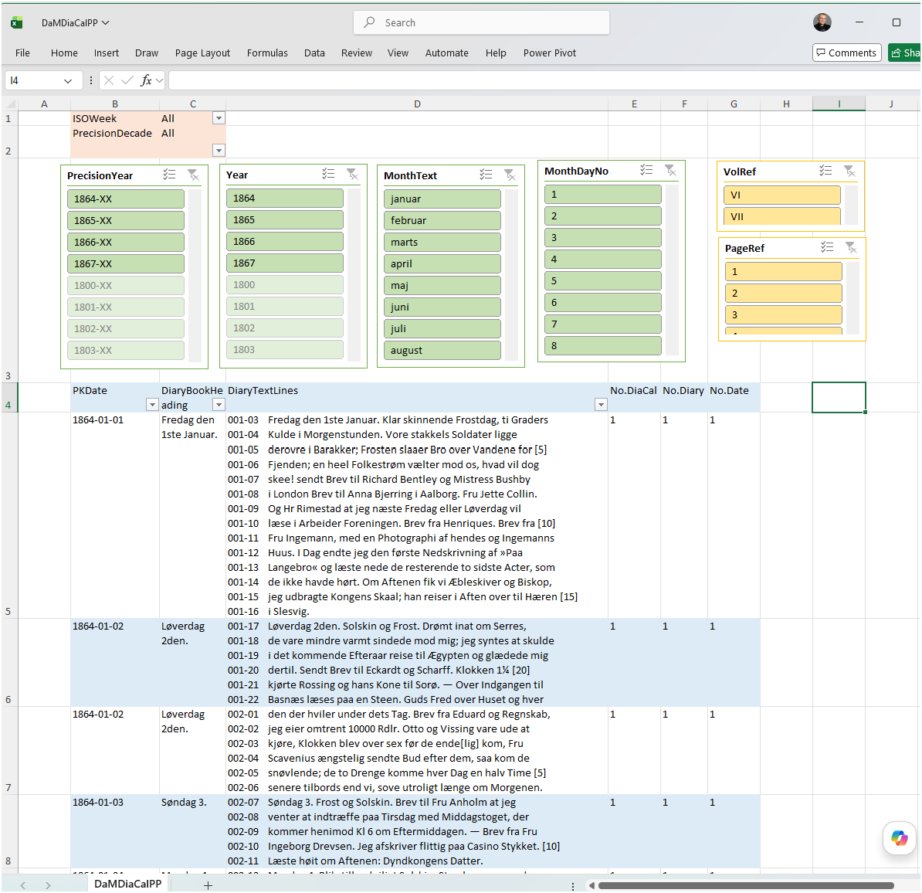
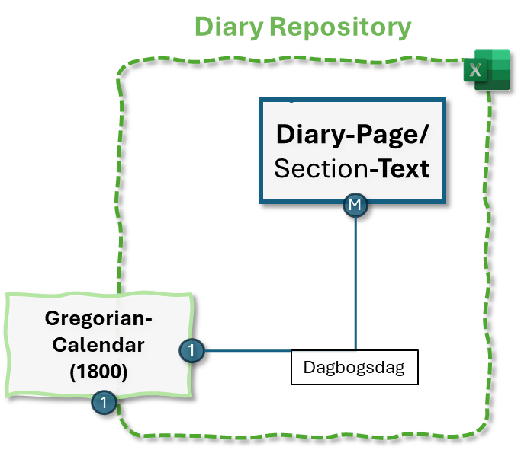
Filter
Slicers
Avanceret sortering og filter

Slide 16
Bygge en fuld-skala MVP i Excel (med Power Query og Power Pivot)
Værker
Personer
Lokationer
….
Excel
Artister
……
Data-tabeller i Excel

Slide 17
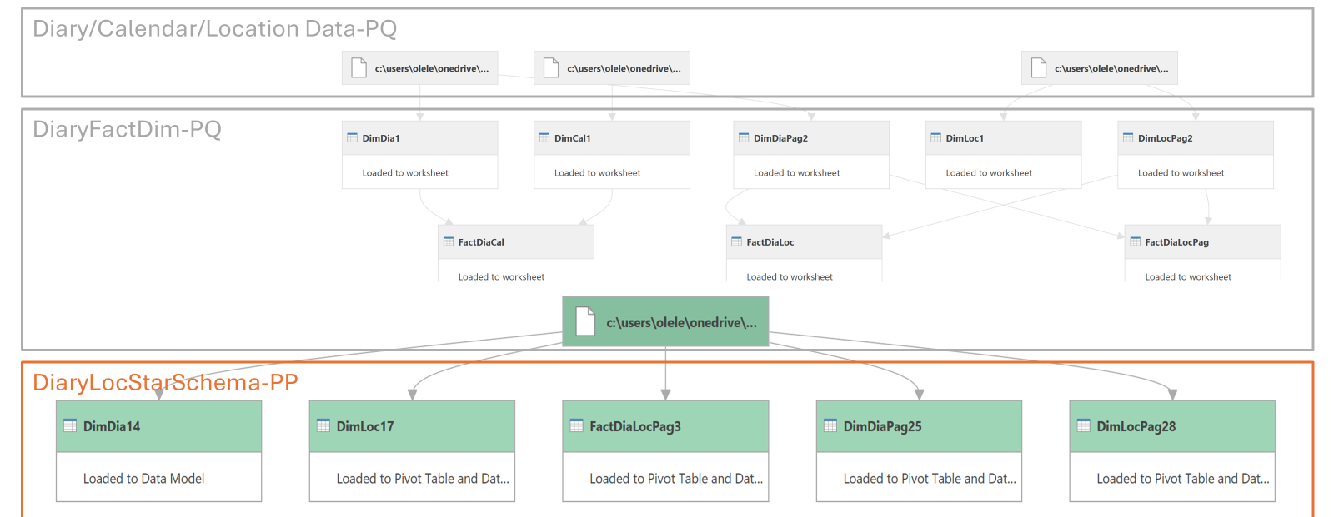
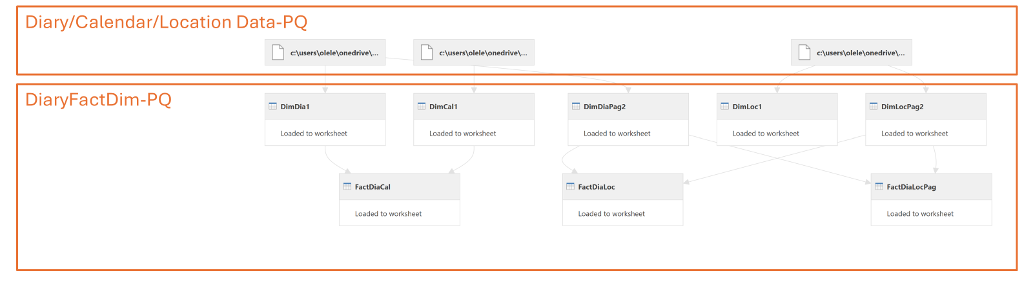
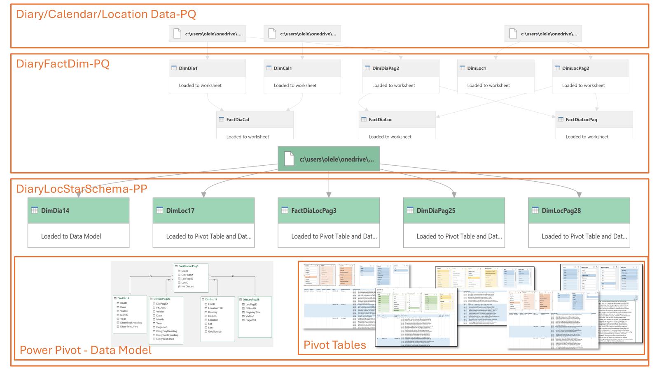
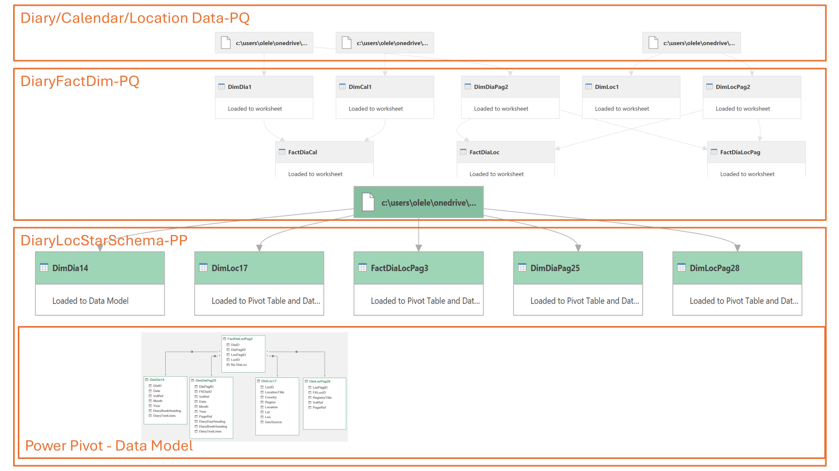
Modeller og struktur bag HCA-Repository

Slide 18
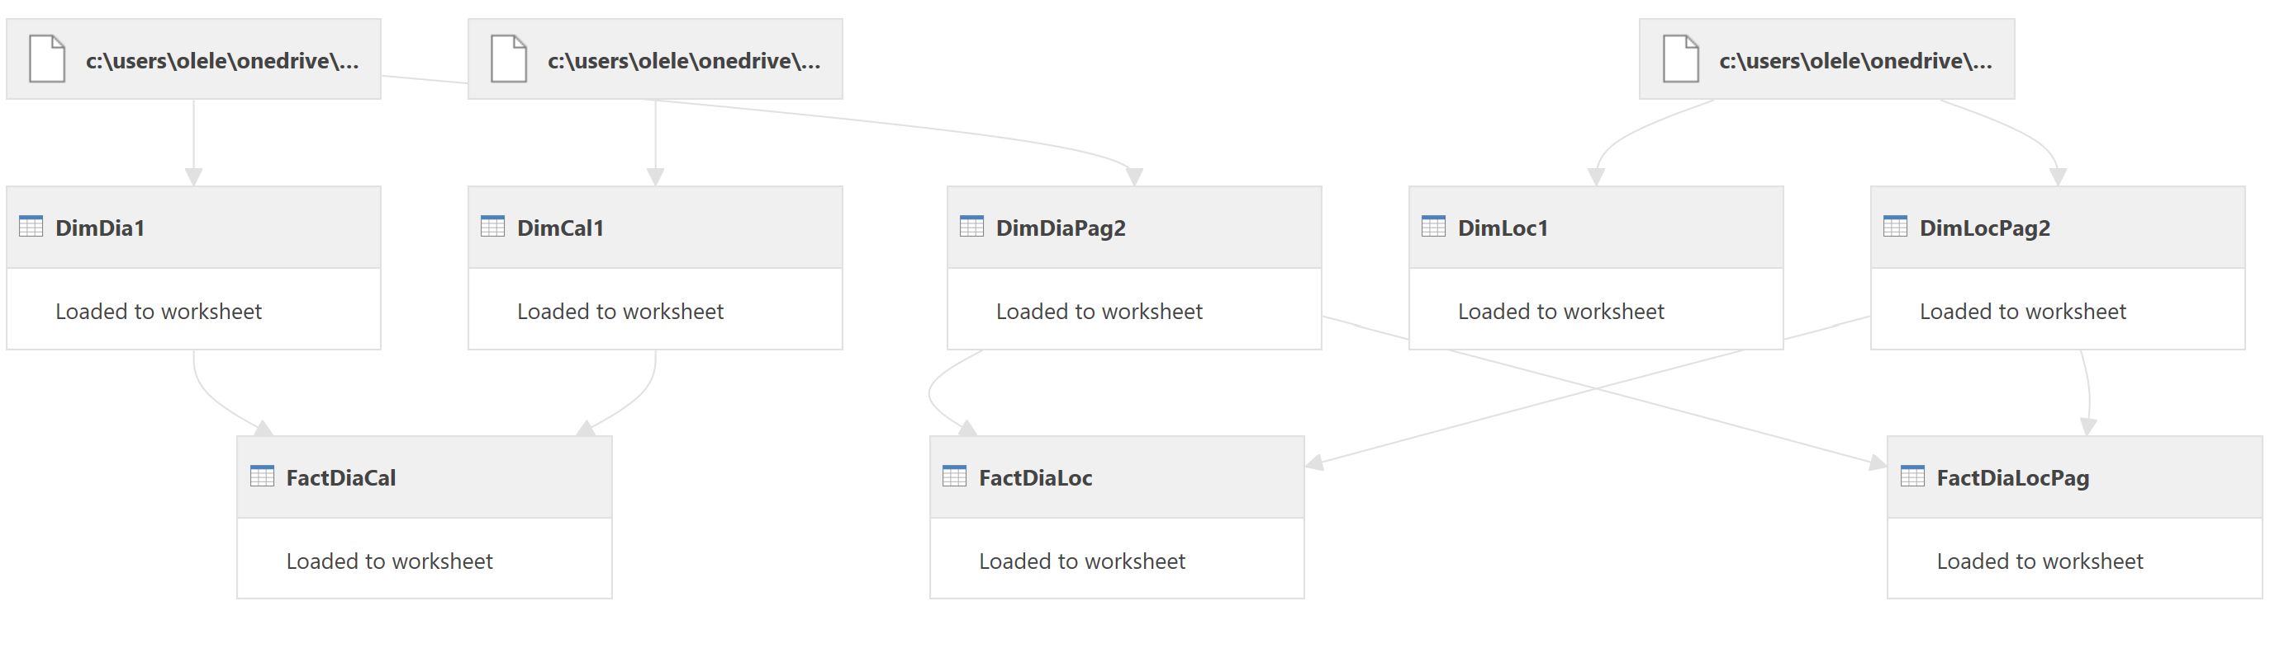
Diary/Calendar/Location Data-PQ
DiaryFactDim-PQ

Slide 19
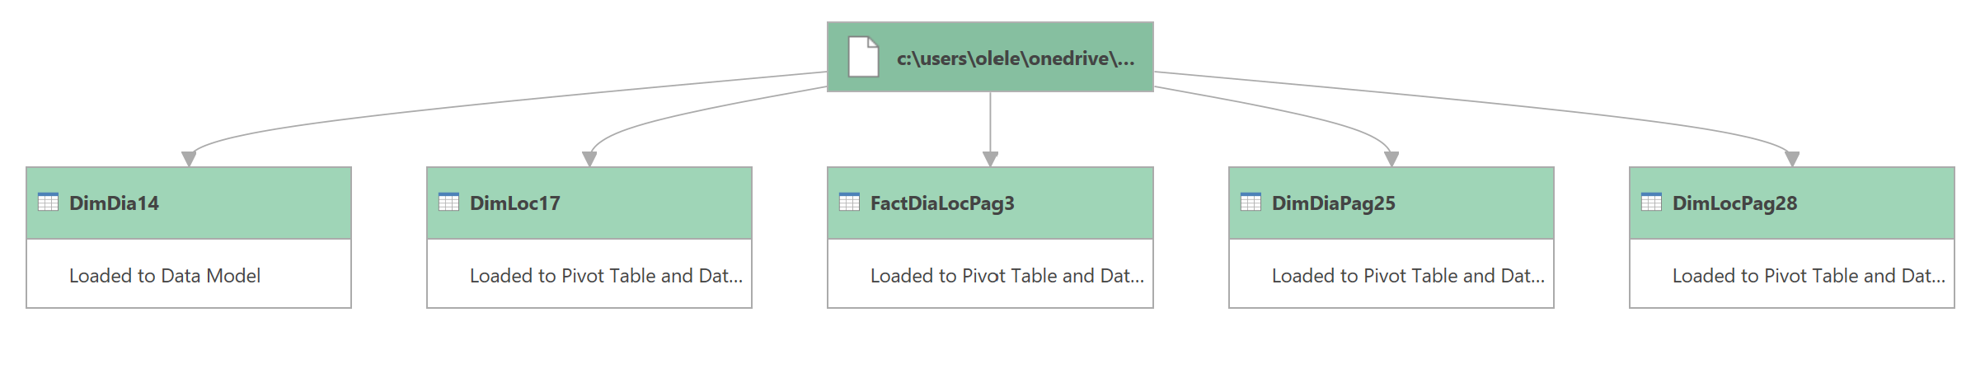
Diary/Calendar/Location Data-PQ
DiaryFactDim-PQ
DiaryLocStarSchema-PP

Slide 20
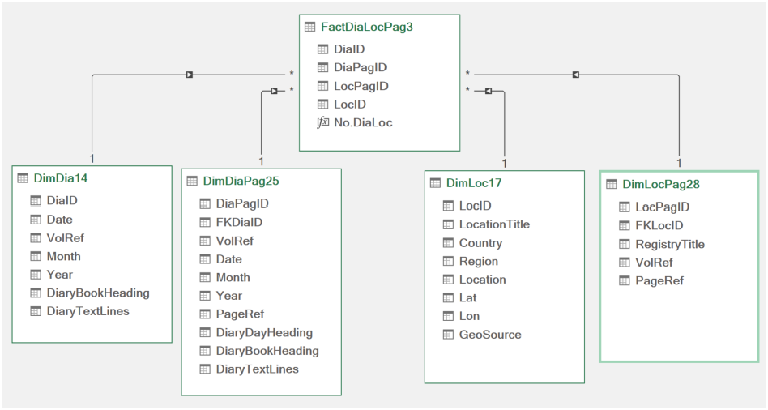
Diary/Calendar/Location Data-PQ
DiaryFactDim-PQ
DiaryLocStarSchema-PP
Power Pivot - Data Model

Slide 21
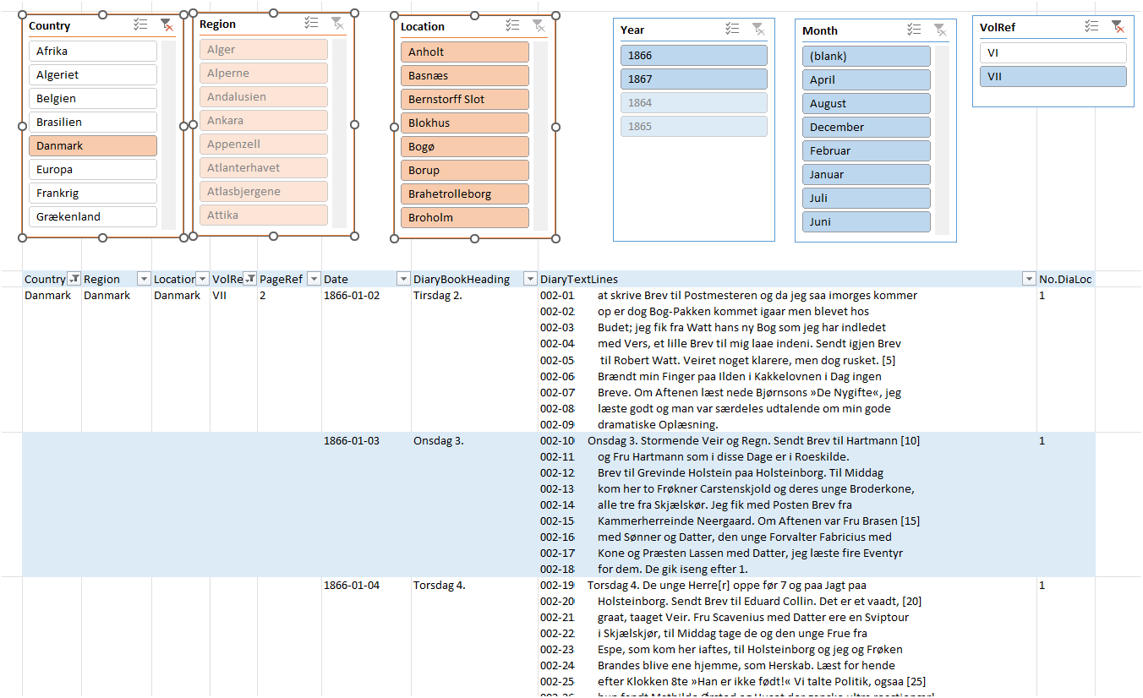
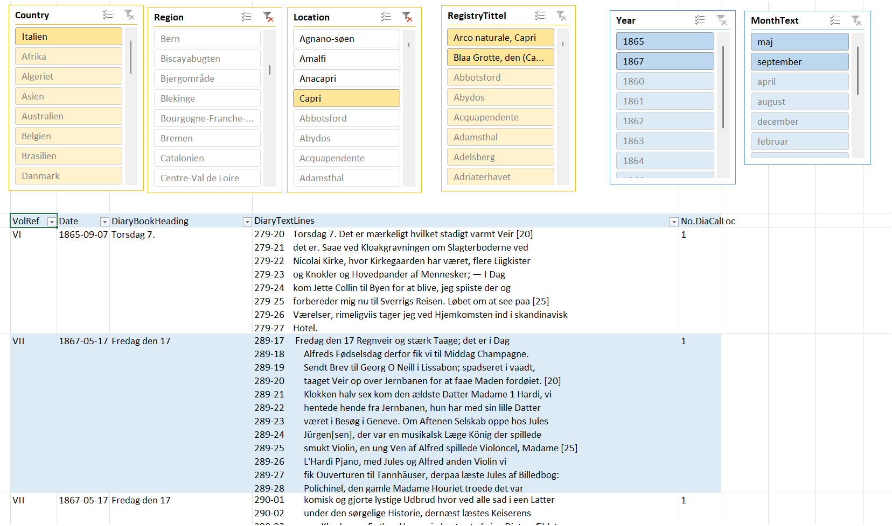
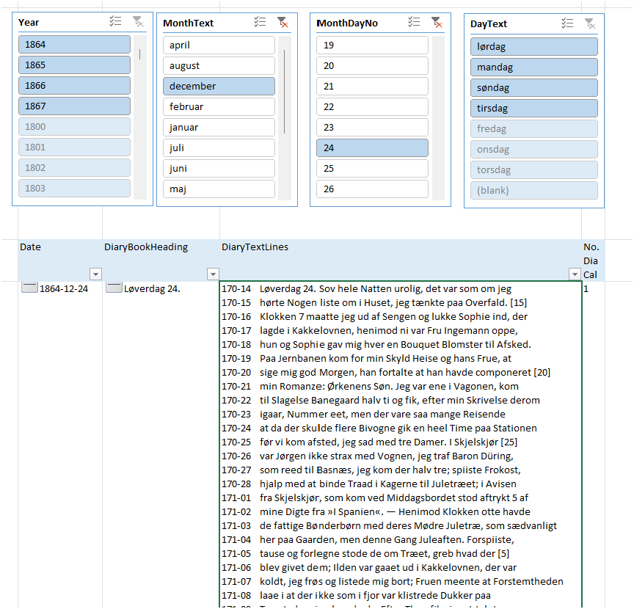
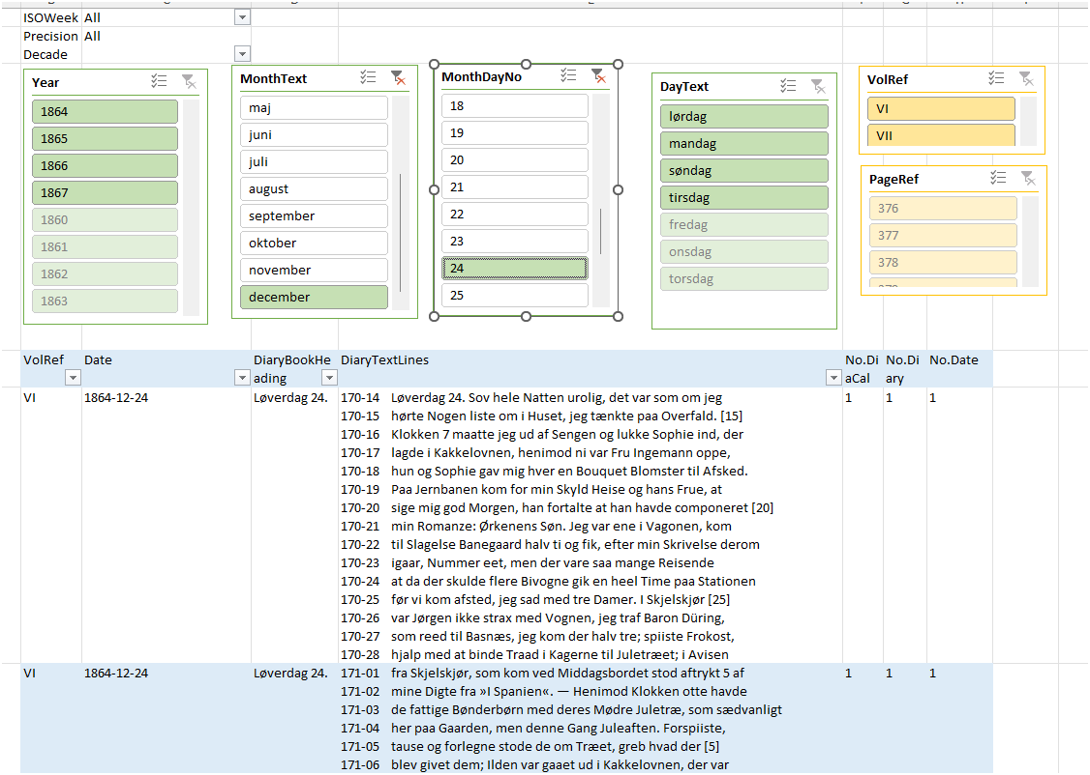
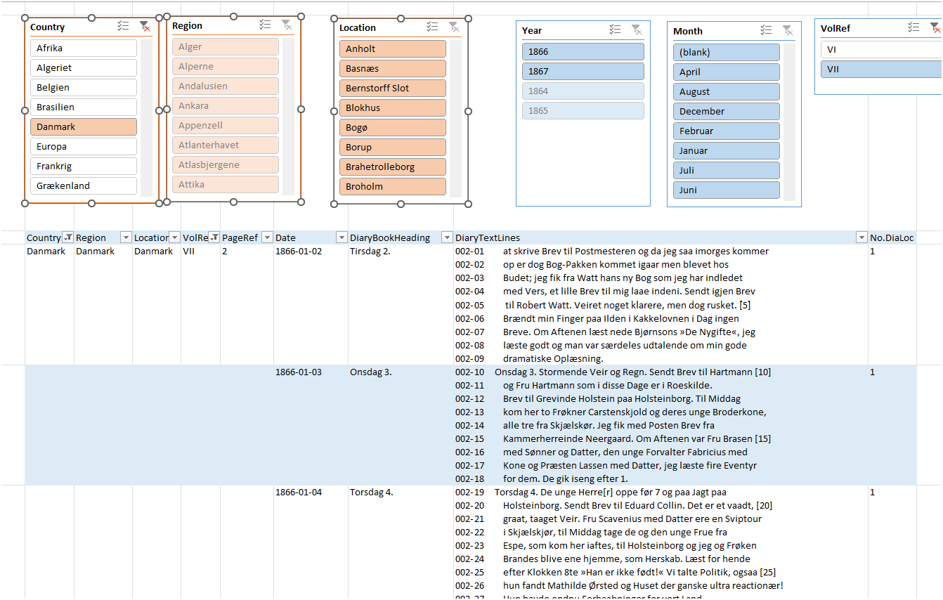
Diary/Calendar/Location Data-PQ
DiaryFactDim-PQ
DiaryLocStarSchema-PP
Power Pivot - Data Model / Star Scema
Pivot Tables

Slide 22
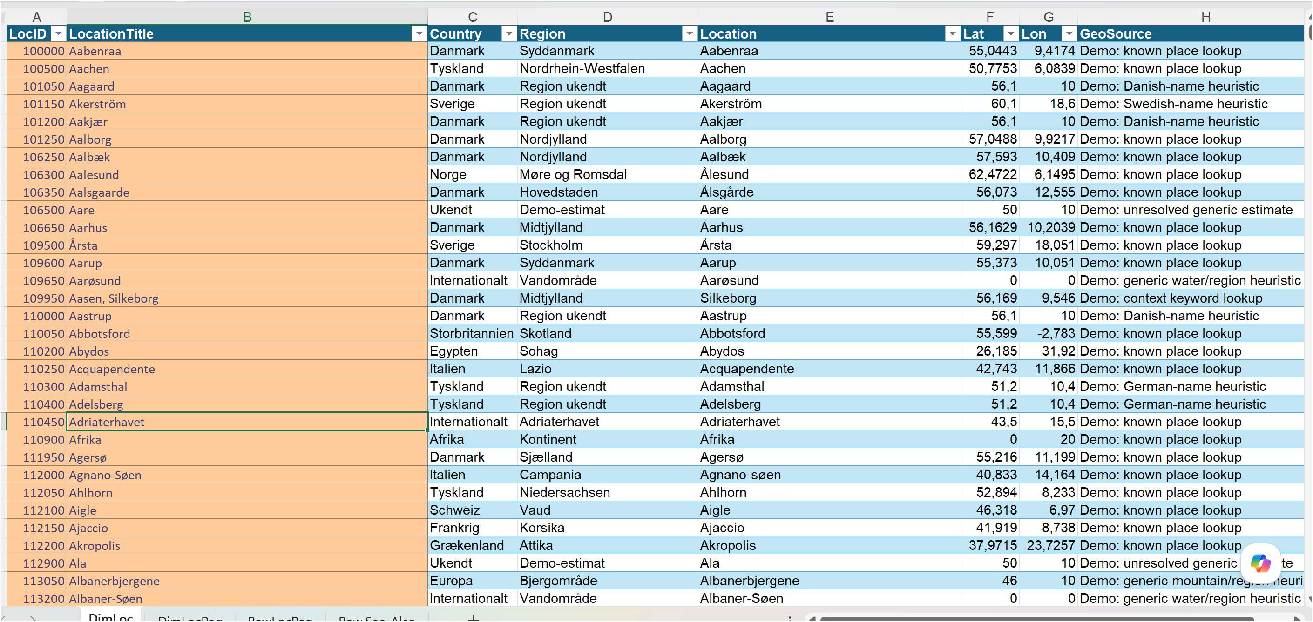
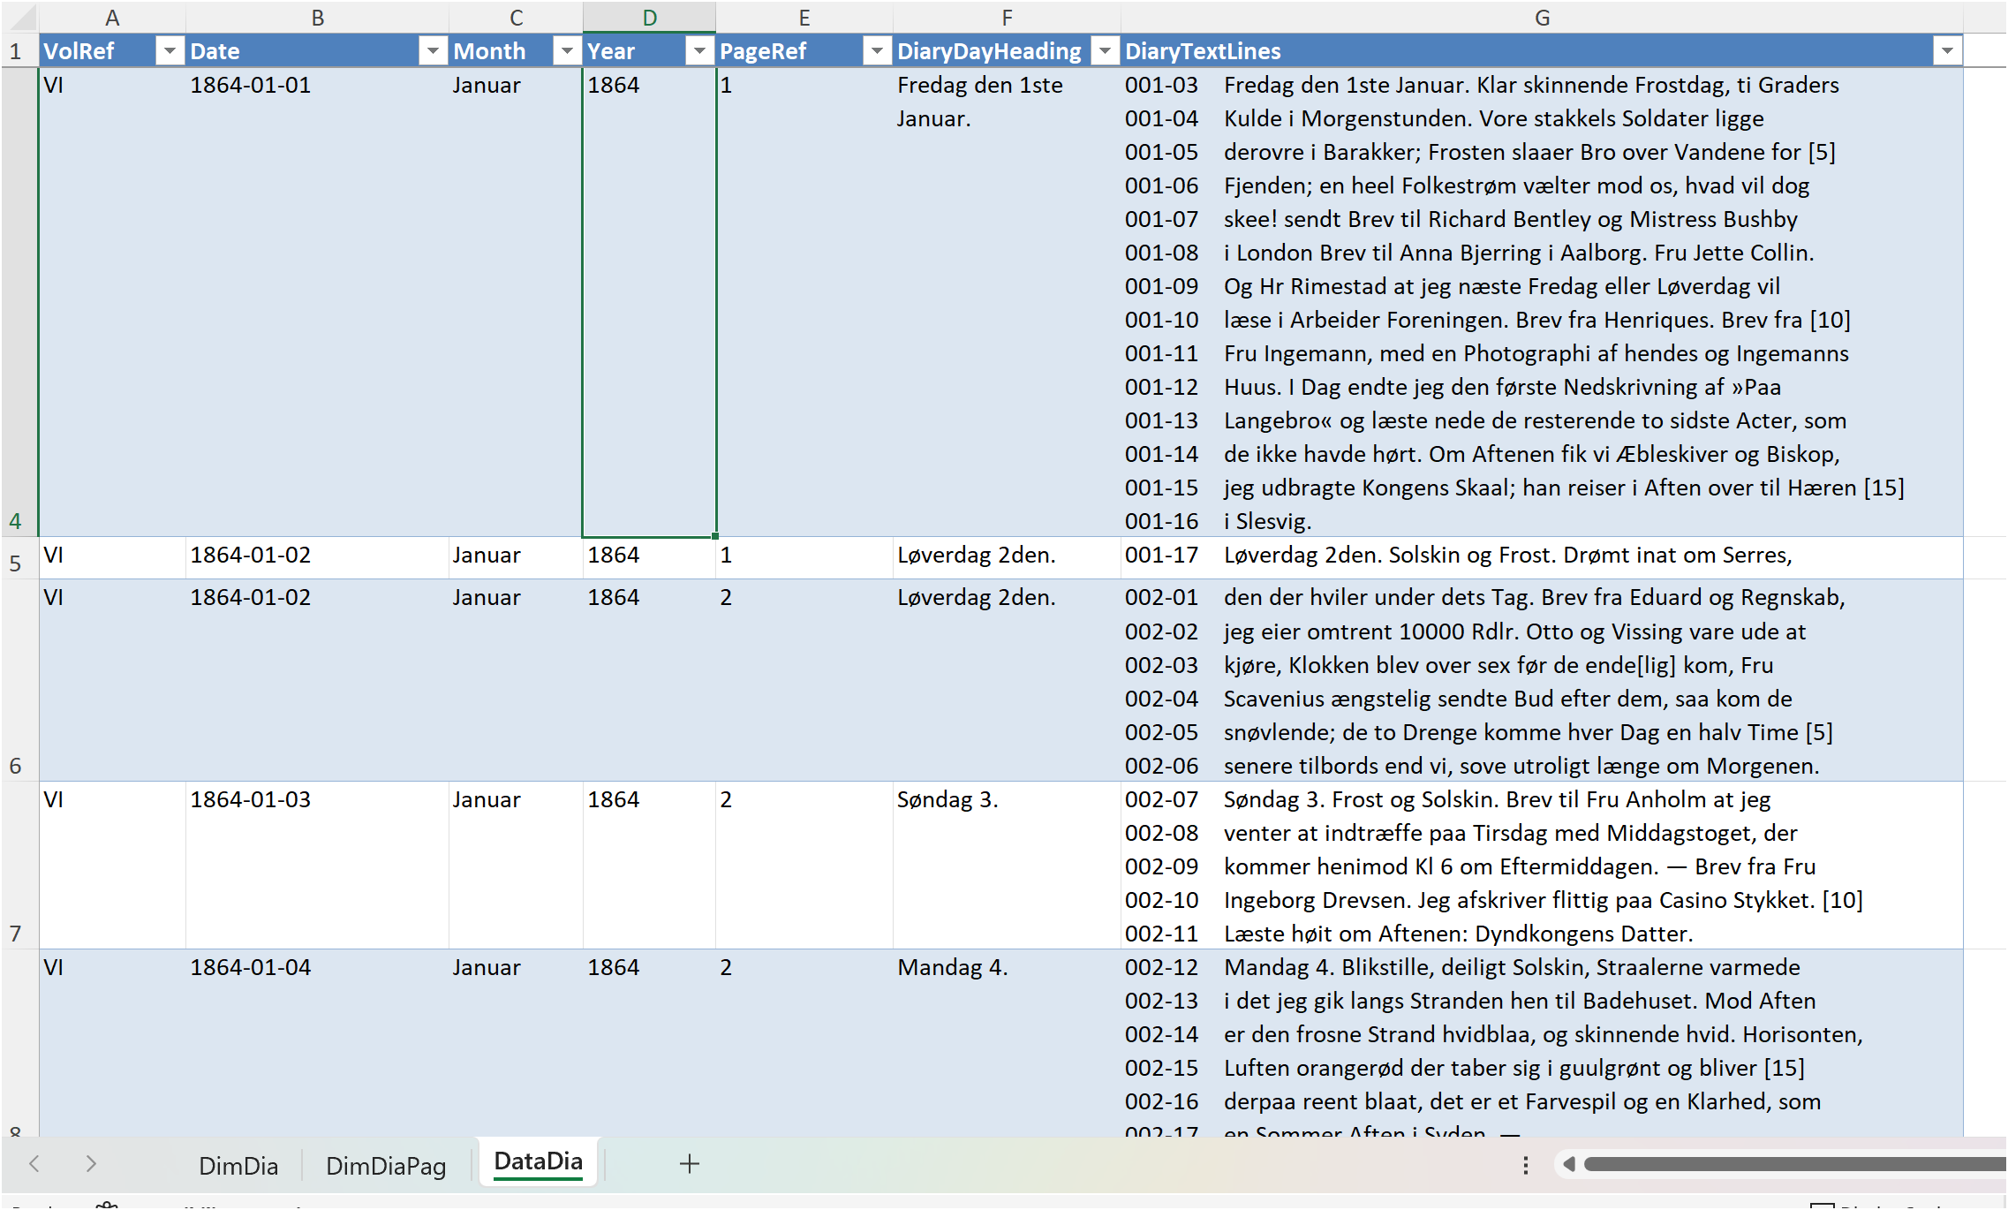
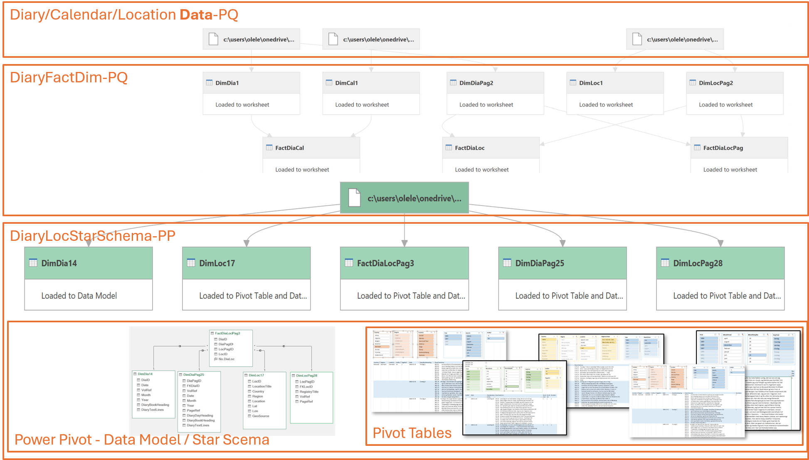
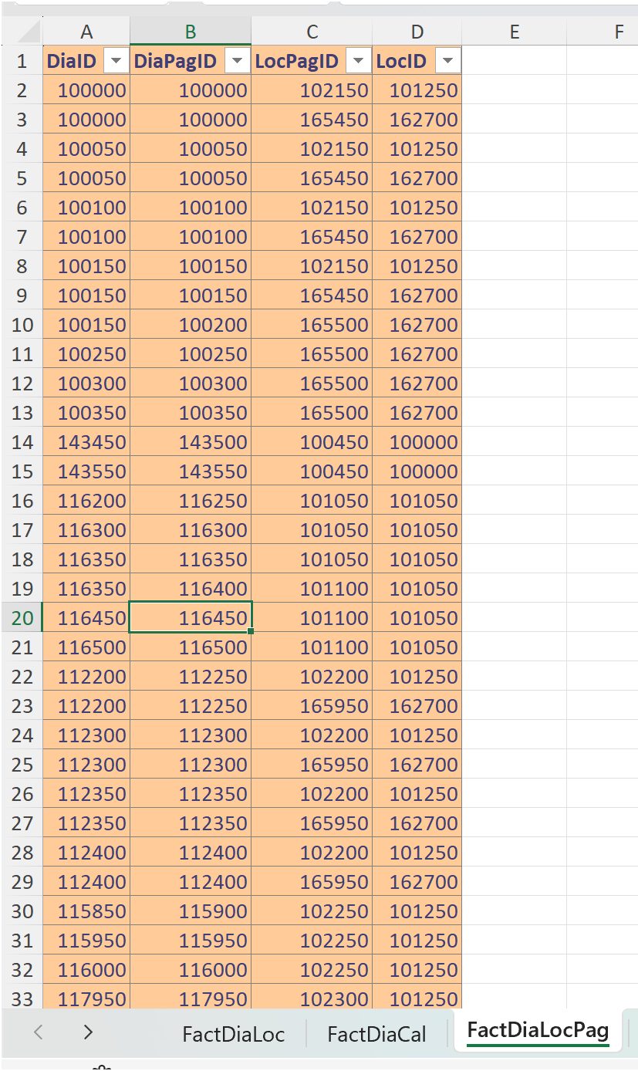
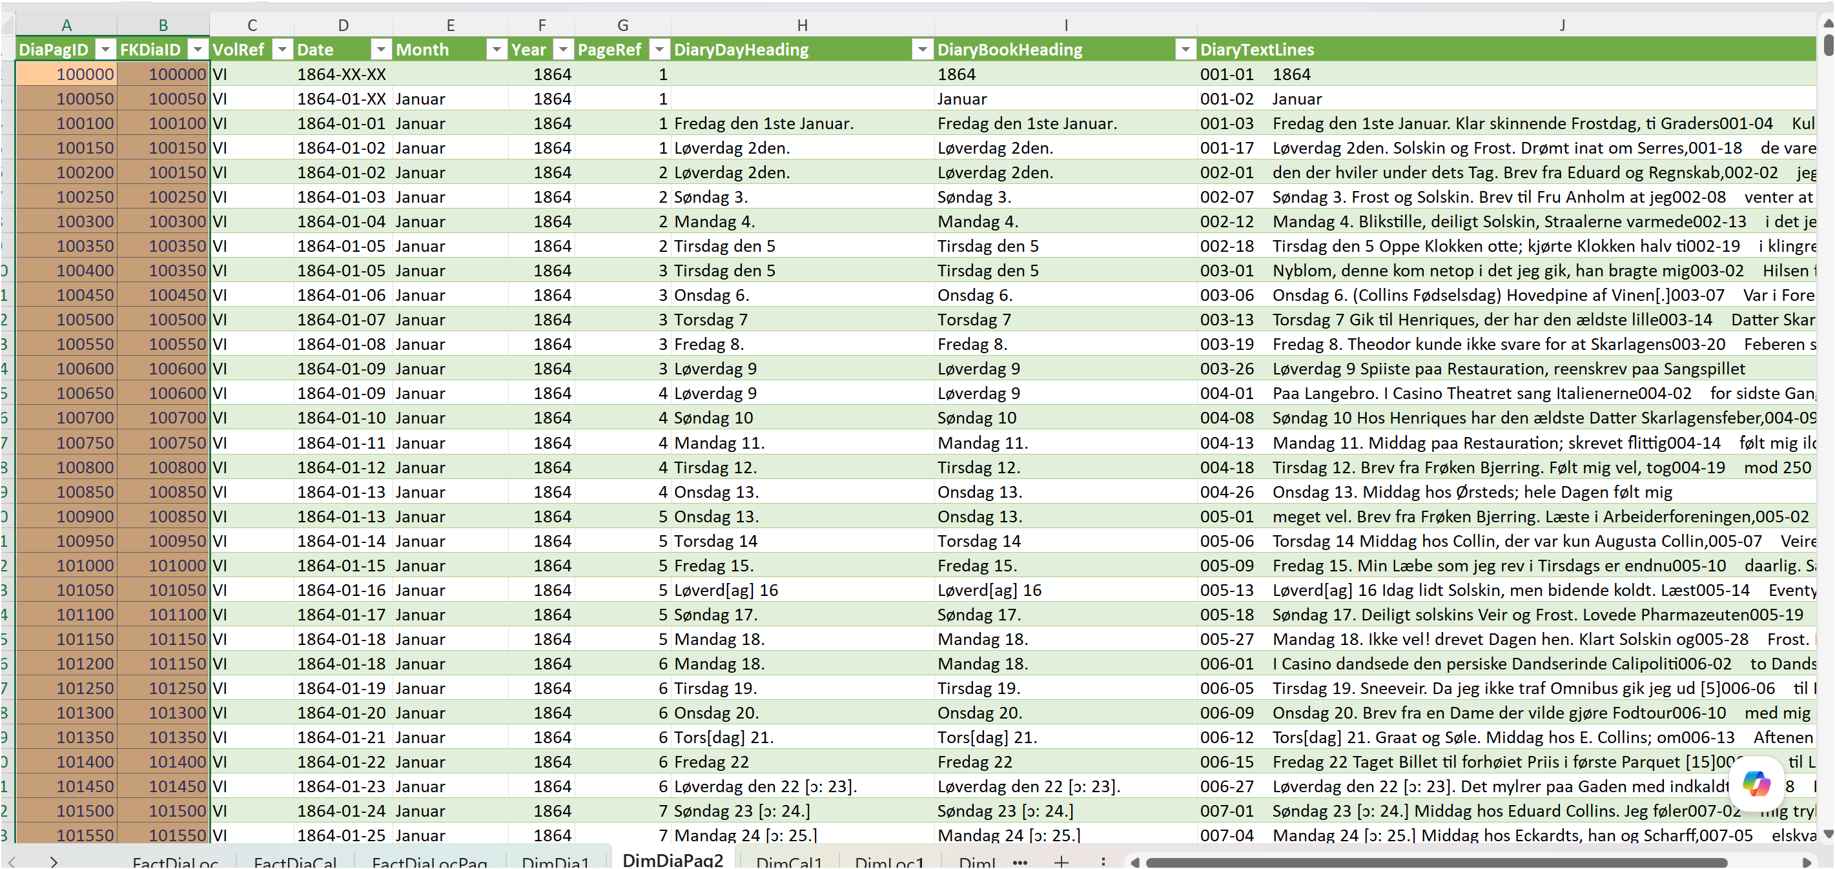
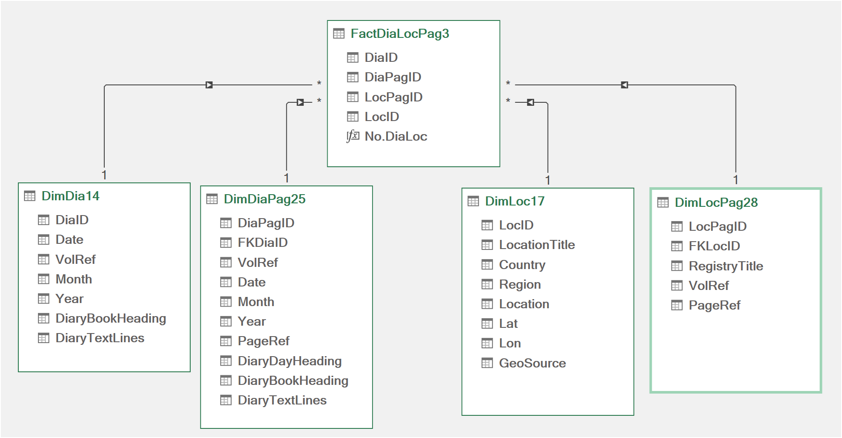
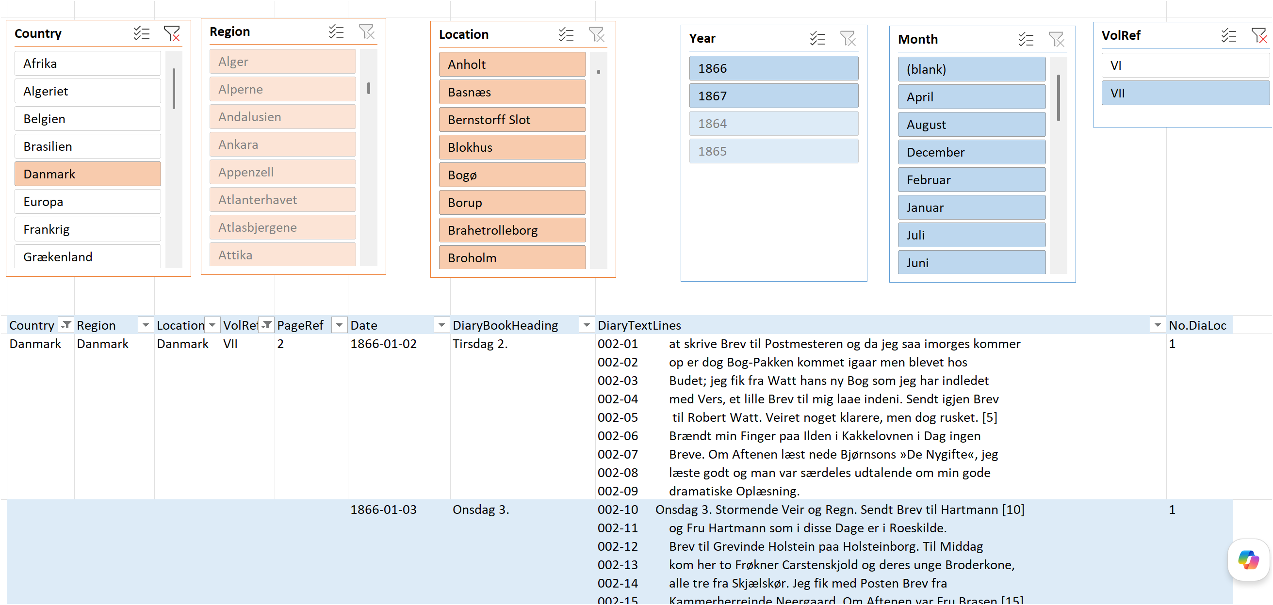
Data Tables
Fact Tables
Power Pivot - Data Model / Star Scema
Dimension Tables
Pivot Tables

Slide 23
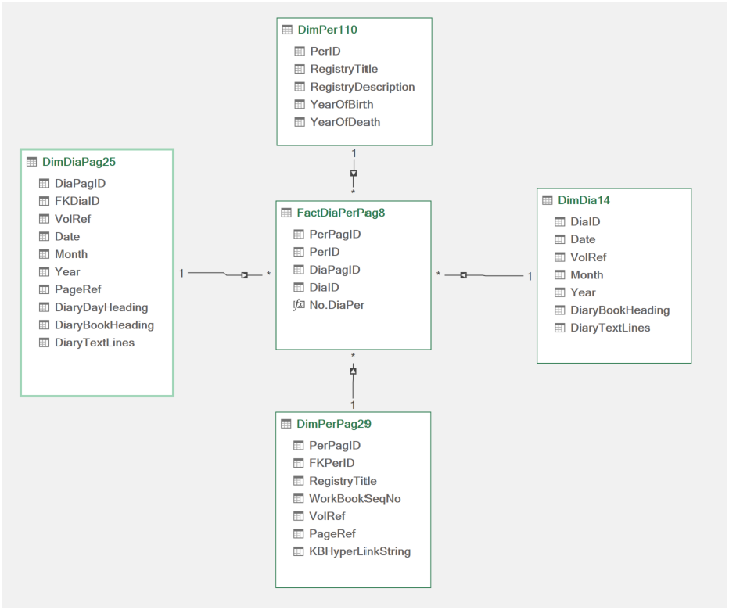

Slide 24
